Slide 1
İŞLETİM SİSTEMLERİ UYGULAMA

Slide 2
Semaphores
A semaphore is a data structure that is shared by several processes.
Semaphores are most often used to synchronize operations, when multiple processes access a common, non-shareable resource.
By using semaphores, we attempt to avoid other multi-programming problems such as:
Starvation
Deadlock

Slide 3
POSIX Semaphores
POSIX semaphores allow processes and threads to synchronize their actions.
A semaphore is an integer whose value is never allowed to fall below zero.
POSIX semaphores come in two forms:
named semaphores
unnamed semaphores.

Slide 4
Named Semaphores
A named semaphore is identified by a name of the form /somename; that is, a null-terminated string
Two processes can operate on the same named semaphore by passing the same name to sem_open().
Named semaphore functions
sem_open()
sem_post()
sem_wait(), sem_timedwait(), sem_trywait()
sem_close()
sem_unlink()

Slide 5
Unnamed Semaphores
An unnamed semaphore does not have a name.
The semaphore is placed in a region of memory that is shared between multiple threads or processes.
A thread-shared semaphore
a global variable.
A process-shared semaphore
must be placed in a shared memory region
POSIX or System V shared memory segment

Slide 6
Unnamed Semaphores
Unnamed semaphore functions
sem_init()
sem_post()
sem_wait(), sem_timedwait(), sem_trywait()
sem_destroy()

Slide 7
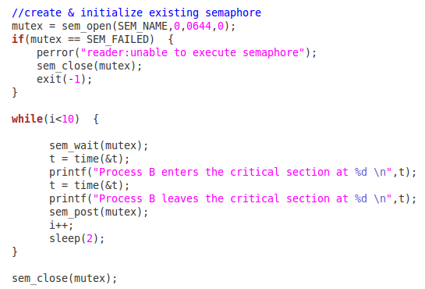
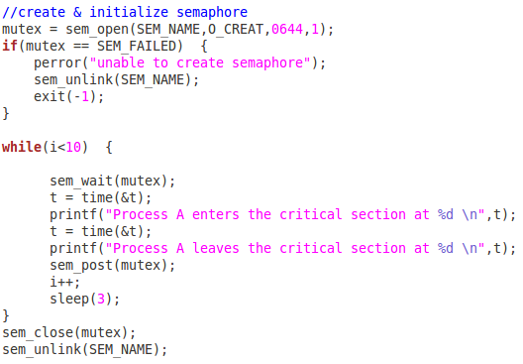
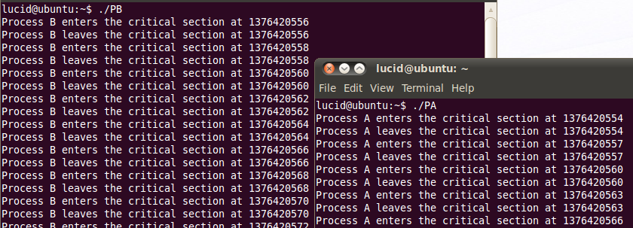
A simple semaphore example
Ex_semA.c
Ex_semB.c

Slide 8
Message Queues
Unlike pipes and FIFOs, message queues support messages that have structure.
Like FIFOs, message queues are persistent objects that must be initially created and eventually deleted when no longer required.
Message queues are created with a specified maximum message size and maximum number of messages.
Message queues are created and opened using a special version of the open system call, mq_open.

Slide 9
POSIX Message Queue Functions
mq_open()
mq_close()
mq_unlink()
mq_send()
mq_receive()
mq_setattr()
mq_getattr()
mq_notify()

Slide 10
mq_open(const char *name, int oflag,...)
name
Must start with a slash and contain no other slashes
QNX puts these in the /dev/mqueue directory
oflag
O_CREAT – to create a new message queue
O_EXCL – causes creation to fail if queue exists
O_NONBLOCK – usual interpretation
mode – usual interpretation
&mqattr – address of structure used during creation

Slide 11
mq_attr structure
This structure, pointed to by the last argument of mq_open, has at least the following members:
mq_maxmsg – maximum number of messages that may be stored in the message queue
mq_msgsize – the size of each message, in bytes
mq_flags – not used by mq_open, but accessed by mq_getattr and mq_setattr
mq_curmsgs – number of messages in the queue

Slide 12
mq_close(mqd_t mqdes)
This function is used to close a message queue after it has been used.
As noted earlier, the message queue is not deleted by this call; it is persistent.
The message queue’s contents are not altered by mq_close unless a prior call(by this or another process) called mq_unlink (see next slide). In this respect, an open message queue is just like an open file: deletion is deferred until all open instances are closed.

Slide 13
mq_unlink(const char *name)
This call is used to remove a message queue.
Recall (from the previous slide) that the deletion is deferred until all processes that have the message queue open have closed it (or terminated).
It is usually a good practice to call mq_unlink immediately after all processes that wish to communicate using the message queue have opened it. In this way, as soon as the last process terminates (closing the message queue), the queue itself is deleted.

Slide 14
Message Queue Persistence - I
As noted, a message queue is persistent.
Unlike a FIFO, however, the contents of a message queue are also persistent.
It is not necessary for a reader and a writer to have the message queue open at the same time. A writer can open (or create) a queue and write messages to it, then close it and terminate.
Later a reader can open the queue and read the messages.

Slide 15
mq_send(mqd_t mqdes, const char *msq_ptr, size_t msglen, unsigned msg_prio)
mqdes
the descriptor required by mq_open
msg_ptr
pointer to a char array containing the message
msglen
number of bytes in the message; this must be no larger than the maximum message size for the queue
prio
the message priority (0..MQ_PRIO_MAX); messages with larger (higher) priority leap ahead of messages with lower (smaller) priority

Slide 16
mq_receive(mqd_t mqdes, char *msq_ptr, size_t msglen, unsigned *msg_prio)
mqdes
the descriptor returned by mq_open
msg_ptr
pointer to a char array to receive the message
msglen
number of bytes in the msg buffer; this should normally be equal to the maximum message size specified when the message queue was created
msg_prio
pointer to a variable that will receive the message’s priority
The call returns the size of the message, or -1

Slide 17
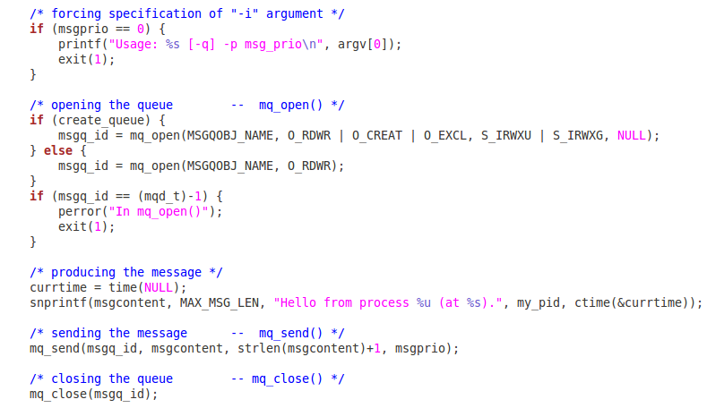
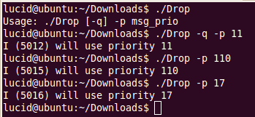
A simple Message Queue Example Sender
Ex_5_mq_dropone.c

Slide 18
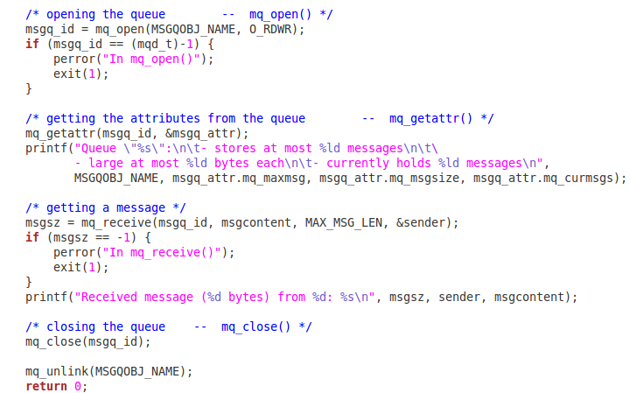
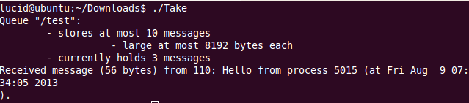
A simple Message Queue Example Receiver
Ex_5_mq_takeone.c

Slide 19
The effect of fork on a message queue
Message queue descriptors are not (in general) treated as file descriptors; the unique open, close, and unlink calls should already suggest this.
Open message queue descriptors are not inherited by child processes created by fork.
Instead, a child process must explicitly open (using mq_open) the message queue itself to obtain a message queue descriptor

Slide 20
Detecting non-empty queues
mq_receive on an empty queue normally causes a process to block, and this may not be desirable.
Of course, O_NONBLOCK could be applied to the queue to prevent this behavior, but in that case the mq_receive call will return -1, and our only recourse is to try mq_receive again later.
With the mq_notify call we can associate a single process with a message queue so that it (the process) will be notified when the message queue changes state from empty to non-empty

Slide 21
mq_notify(mqd_t mqdes, const struct sigevent *notification)
queuefd
as usual, to identify the message queue
sigev
a struct sigevent object that identifies the signal to be sent to the process to notify it of the queue state change.
Once notification has been sent, the notification mechanism is removed. That is, to be notified of the next state change (from empty to non-empty), the notification must be reasserted.

Slide 22
Changing the process to be notified
Only one process can be registered (at a time) to receive notification when a message is added to a previously-empty queue.
If you wish to change the process that is to be notified, you must remove the notification from the process which is currently associated (call mq_notify with NULL for the sigev argument), and then associate the notification with a different process.

Slide 23
Attributes
mq_getattr (queuefd,&mqstat)
retrieves the set of attributes for a message queue to the struct mq_attr object named mqstat.
the mq_flags member of the attributes is not significant during mq_open, but it can be set later
mq_setattr (queuefd,&mqstat,&old)
Set (or clear) to O_NONBLOCK flag in the mqattr structure for the identified message queue
Retrieve (if old is not NULL) the previously existing message queue attributes
Making changes to any other members of the mqattr structure is ineffective.

Slide 24
Timed send and receive
Two additional functions, mq_timedsend and mq_timedreceive, are like mq_send and mq_receive except they have an additional argument, a pointer to a struct timespec.
This provides the absolute time at which the send or receive will be aborted if it cannot be completed (because the queue is full or empty, respectively).

Slide 25
Shared Memory
Sharing memory in POSIX (and many other systems) requires
creating a persistent “object” associated with the shared memory, and
allowing processes to connect to the object.
creating or connecting to the persistent object is done in a manner similar to that for a file, but uses the shm_open system call.

Slide 26
Shared Memory Functions
shm_open()
mmap()
munmap()
ftruncate()
shm_unlink()

Slide 27
shm_open (name, oflag, mode)
name is a string identifying an existing shared memory object or a new one (to be created). It should begin with ‘/’, and contain only one slash. In QNX 6, these objects will appear in a special directory.
mode is the protection mode (e.g. 0644).
shm_open returns a file descriptor, or –1 in case of error

Slide 28
shm_open (name, oflag, mode)
oflag is similar to the flags for files:
O_RDONLY – read only
O_RDWR – read/write
O_CREAT – create a new object if necessary
O_EXCL – fail if O_CREAT and object exists
O_TRUNC – truncate to zero length if opened R/W

Slide 29
ftruncate(int fd, off_t len)
This function (inappropriately named) causes the file referenced by fd to have the size specified by len.
If the file was previously longer than len bytes, the excess is discarded.
If the file was previously shorter than len bytes, it is extended by bytes containing zero.

Slide 30
mmap (void *addr, size_t len, int prot, int flags, int fd, off_t off);
mmap is used to map a region of the shared memory object (fd) to the process’ address space.
The mapped region has the given len starting at the specified offset off.
Normally addr is 0, and allows the OS to decide where to map the region. This can be explicitly specified, if necessary.
mmap returns the mapped address, or –1 on error.(more on next slide)

Slide 31
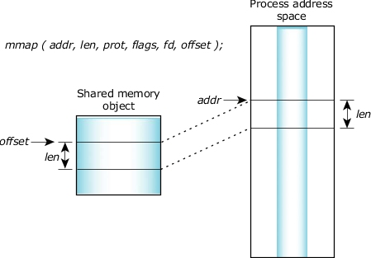
Mmap()

Slide 32
mmap, continued
prot – selected from the available protection settings:
PROT_EXEC
PROT_NOCACHE
PROT_NONE
PROT_READ
PROT_WRITE
flags – one or more of the following:
MAP_FIXED – interpret addr parameter exactly
MAX_PRIVATE – don’t share changes to object
MAP_SHARED – share changes to object

Slide 33
munmap (void *addr, size_t len)
This function removes mappings from the specified address range.
This is not a frequently-used function, as most processes will map a fixed-sized region and use shm_unlink at the end of execution to destroy the shared memory object (which effectively removes the mappings).

Slide 34
shm_unlink (char *name);
This function, much like a regular unlink system call, removes a reference to the shared memory object.
If the are other outstanding links to the object, the object itself continues to exist.
If the current link is the last link, then the object is deleted as a result of this call.

Slide 35
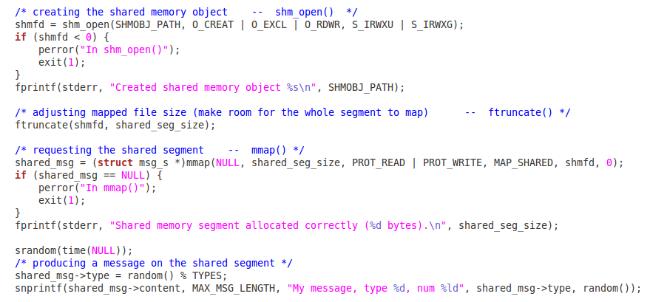

A Simple Shared Memory Example Sender
Ex_6_shm_server.c

Slide 36
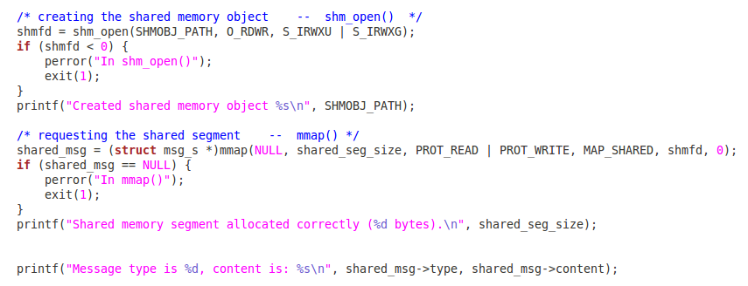

A Simple Shared Memory Example Receiver
Ex_6_shm_client.c

Slide 37
References
http://cs.unomaha.edu/~stanw/091/csci8530/
http://mij.oltrelinux.com/devel/unixprg/
Man pages
man mq_overview
man mq_open, mq_close etc. etc. etc.
http://forum.soft32.com/linux2/Utilities-listing-removing-POSIX-IPC-objects-ftopict15659.html

Slide 38
Threads vs. Processes
Creation of a new process using fork is expensive (time & memory).
A thread (sometimes called a lightweight process) does not require lots of memory or startup time.

Slide 39
fork()
Process A
Global
Variables
Process B
Global
Variables
fork()
Code
Code
Stack
Stack

Slide 40
pthread_create()
Process A
Thread 1
Global
Variables
pthread_create()
Code
Process A
Thread 2
Stack
Stack

Slide 41
Multiple Threads
Each process can include many threads.
All threads of a process share:
memory (program code and global data)
open file/socket descriptors
signal handlers and signal dispositions
working environment (current directory, user ID, etc.)

Slide 42
Thread-specific Resources
Each thread has its own
Thread ID
Stack, Registers, Program Counter
Threads within the same process can communicate using shared memory.
Must be done carefully

Slide 43
Posix Threads
We will focus on Posix Threads - most widely supported threads programming API.
you need to link with “-lpthread”

Slide 44
Thread Creation
pthread_create(
pthread_t *tid,
const pthread_attr_t *attr,
void *(*func)(void *),
void *arg);
func is the function to be called.
when func() returns the thread is terminated.

Slide 45
pthread_create()
The return value is 0 for OK.
positive error number on error.
Does not set errno !!!
Thread ID is returned in tid

Slide 46
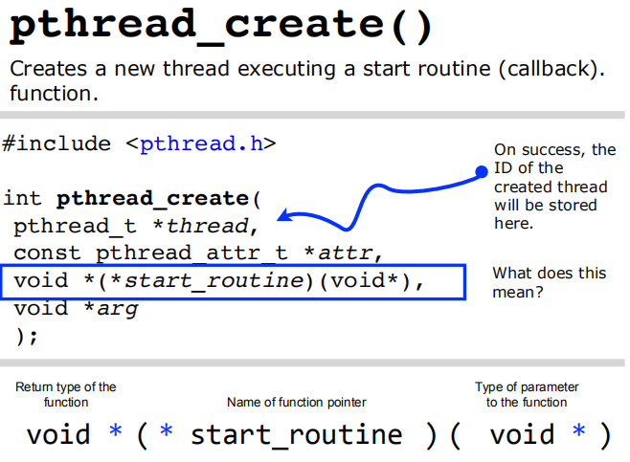

Slide 47
Thread IDs
Each thread has a unique ID, a thread can find out it's ID by calling pthread_self().
Thread IDs are of type pthread_t which is usually an unsigned int. When debugging, it's often useful to do something like this:
printf("Thread %u:\n",pthread_self());

Slide 48
Thread Arguments
When func() is called the value arg specified in the call to pthread_create() is passed as a parameter.
func can have only 1 parameter, and it can't be larger than the size of a void *.

Slide 49
Thread Arguments (cont.)
Complex parameters can be passed by creating a structure and passing the address of the structure.
The structure can't be a local variable (of the function calling pthread_create)!!
threads have different stacks!

Slide 50
Thread args example
struct { int x,y } 2ints;
void *blah( void *arg) {
struct 2ints *foo = (struct 2ints *) arg;
printf("%u sum of %d and %d is %d\n",
pthread_self(),
foo->x, foo->y,
foo->x+foo->y);
return(NULL);
}

Slide 51
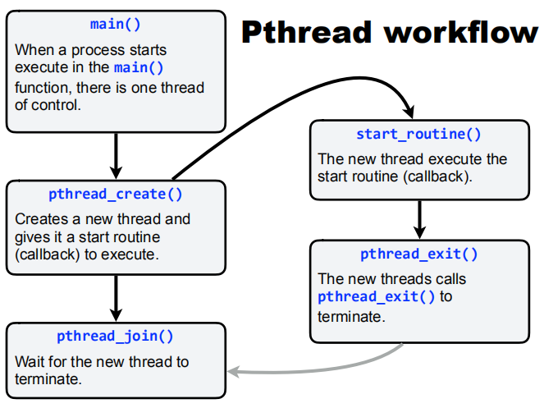

Slide 52
Thread Lifespan
Once a thread is created, it starts executing the function func() specified in the call to pthread_create().
If func() returns, the thread is terminated.
A thread can also be terminated by calling pthread_exit().
If main() returns or any thread calls exit()all threads are terminated.

Slide 53
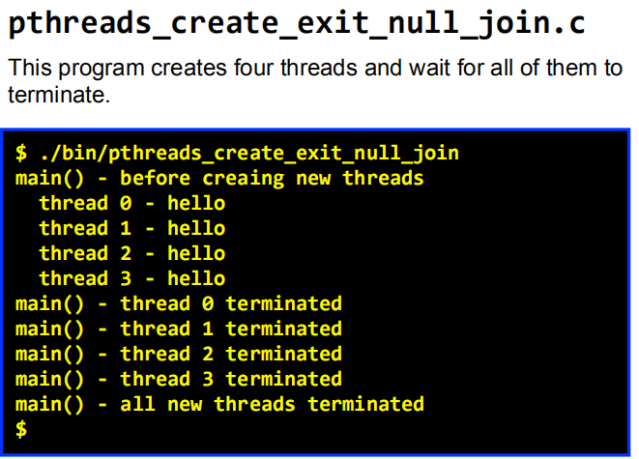
Ex_1_pthread1.c

Slide 54
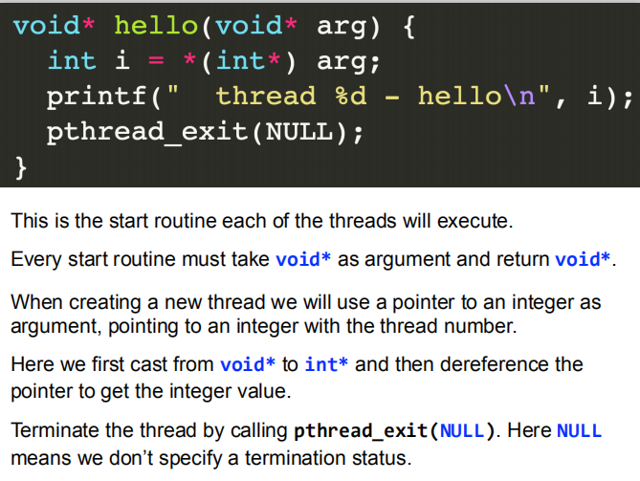

Slide 55
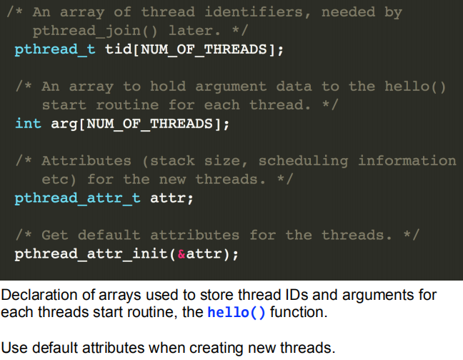

Slide 56
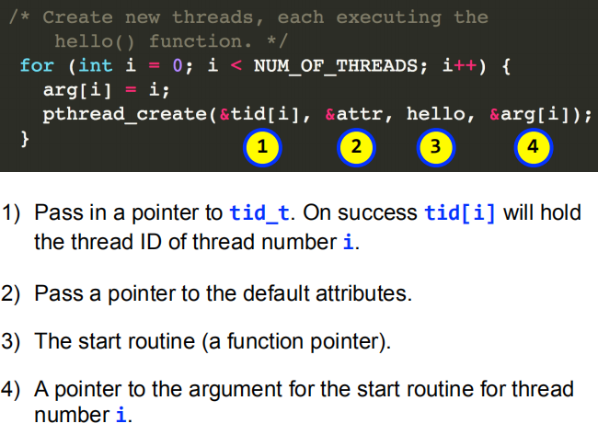

Slide 57
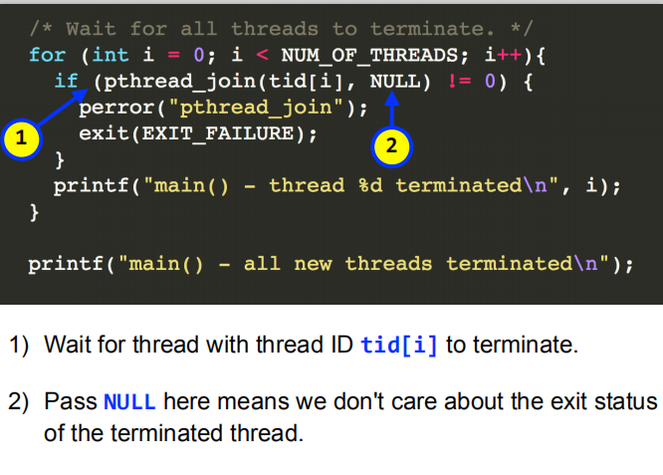
Ex_2_pthread2.c

Slide 58
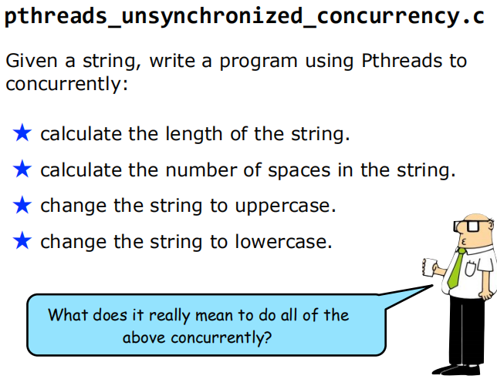

Slide 59
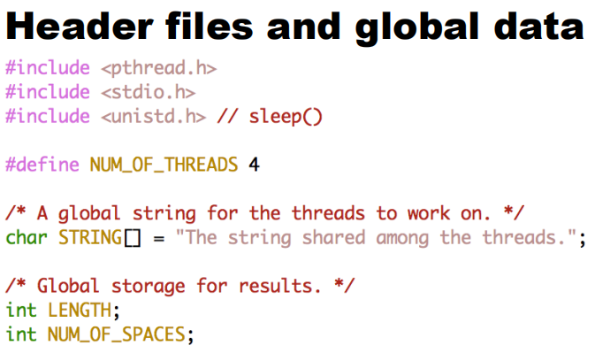
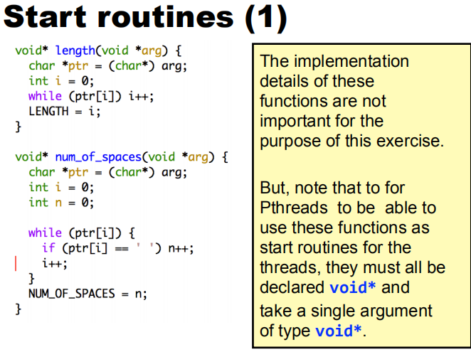

Slide 60
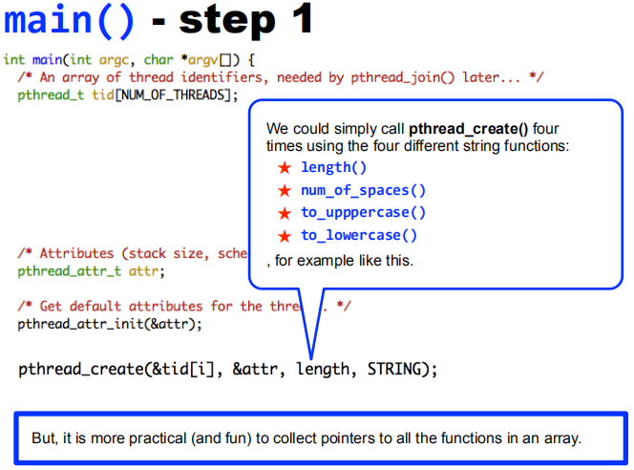
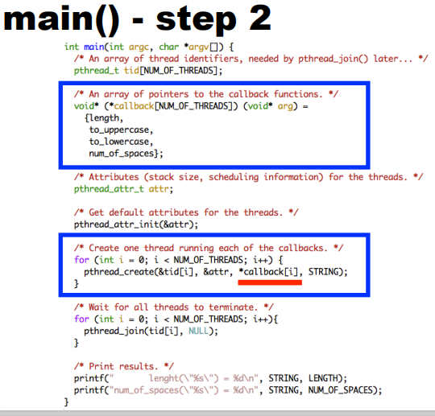

Slide 61
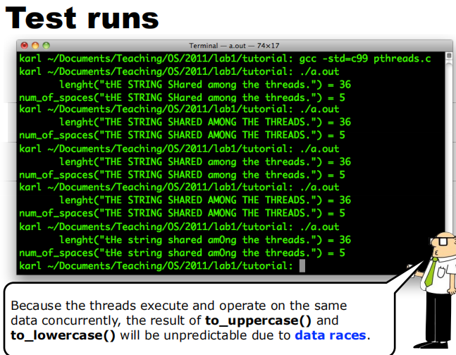
Ex_3_pthread3.c

Slide 62
Detached vs. Joinable
Ex_4_pthread4.c
Each thread can be either joinable or detached.
Joinable: on thread termination the thread ID and exit status are saved by the OS.
Detached: on termination all thread resources are released by the OS. A detached thread cannot be joined.

Slide 63
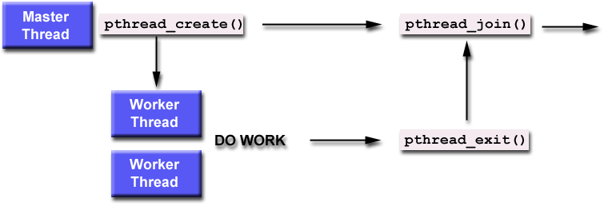
Detached vs. Joinable (Contd.)

Slide 64
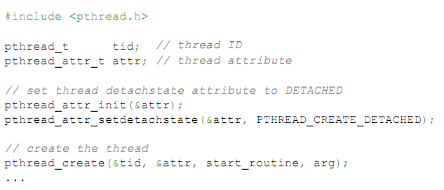
Howto detach
Ex_5_pthread5.c

Slide 65
Shared Global Variables
Possible problems
Global variables
Avoiding problems
Synchronization Methods
Mutexes
Condition variables

Slide 66
Possible problems
Sharing global variables is dangerous - two threads may attempt to modify the same variable at the same time.
Just because you don't see a problem when running your code doesn't mean it can't and won't happen!!!!

Slide 67
Avoiding problems
pthreads includes support for Mutual Exclusion primitives that can be used to protect against this problem.
The general idea is to lock something before accessing global variables and to unlock as soon as you are done.
Shared socket descriptors should be treated as global variables!!!

Slide 68
Mutexes
Ex_6_pthread6.c
A global variable of type pthread_mutex_t is required:
pthread_mutex_t counter_mtx = PTHREAD_MUTEX_INITIALIZER;
Initialization to PTHREAD_MUTEX_INITIALIZER is required for a static variable!

Slide 69
Lock & Unlock
To lock use:
pthread_mutex_lock(pthread_mutex_t &);
To unlock use:
pthread_mutex_unlock(pthread_mutex_t &);
Both functions are blocking!

Slide 70
Condition Variables
pthreads support condition variables, which allow one thread to wait (sleep) for an event generated by any other thread.
This allows us to avoid the busy waiting problem.
pthread_cond_t foo = PTHREAD_COND_INITIALIZER;

Slide 71
Condition Variables (cont.)
A condition variable is always used with mutex.
pthread_cond_wait(pthread_cond_t *cptr,
pthread_mutex_t *mptr);
pthread_cond_signal(pthread_cond_t *cptr);
Ex_7_pthread7.c
don’t let the word signal confuse you -
this has nothing to do with Unix signals

Slide 72
Summary
Threads are awesome, but dangerous. You have to pay attention to details or it's easy to end up with code that is incorrect (doesn't always work, or hangs in deadlock).
Posix threads provides support for mutual exclusion, condition variables and thread-specific data.
IHOP serves breakfast 24 hours a day!

Slide 73
References
https://github.com/uu-os-2019/
Getting Started With POSIX Threads by Tom Wagner & Don Towsley Department of Computer Science University of Massachusetts at Amherst July 19, 1995

